Slide 1
User Question Answering
AI-Powered Team Collaboration
Devanshi Mathan | Er. No.: 221B142

Slide 2



What is the User Question Answering?
The User Question Answering is an innovative web application designed to answer general knowledge questions.
Interactive Web App
AI-Powered Question Matching
Target Users
Answers General Knowledge Questions.
Bulit using Streamlit (UI), TF-IDF + cosine similarity (text matching), and NLTK preprocessing.
Students, quiz enthusiasts, learners.

Slide 3





Core Features
Question input and
answer display
Confidence score with color coding
Sidebar: project info, instructions, stats
Random question generator
Category-based suggestions

Slide 4
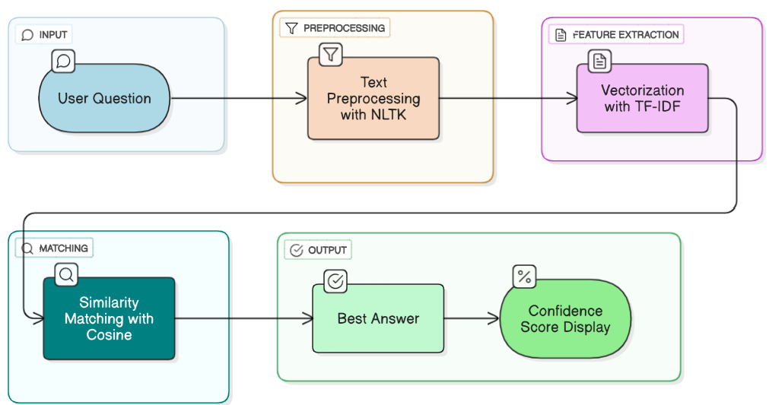
How It Works
01
Natural Conversation
Users engage in natural chat, subtly mentioning meeting intentions or desired times.
02
AI Detection & Preference Gathering
The AI system proactively detects meeting-related keywords and aggregates participant preferences.
03
Optimal Slot Identification
The application computes and identifies the most convenient time slot that minimizes conflicts.
04
Instant Confirmation
Confirmation emails are automatically generated and sent to all involved parties, finalizing the meeting.

Slide 5
Technology Stack
The User Question Answering is built upon a robust and efficient technology stack, ensuring scalability and performance.
Backend
Frontend
AI/NLP
Requirements
Python: A micro-framework for rapid API development, TF-IDF vectorizer.
HTML: For structuring the web application's content.
Custom Logic: Tailored algorithms for precise intent recognition and availability extraction from natural language.
Dependencies: Streamlit, Pandas, Numpy, Scikit-learn, NLTK
CSS: For styling and responsive design across devices.
SQLite: A lightweight, file-based database for local data storage.
JavaScript: For interactive elements and dynamic user experiences.

Slide 6
Knowledge Base
The database is designed for efficient storage of categories:
Science
Geography
History
Sports
Literature & Arts
Technology
Examplr Q&A:
Q: What is the capital of France?
A: Paris.

Slide 7

Implementation Details
Preprocessing
Lowercases, punctuation removal, whitespace cleaning.
Vectorization
TF-IDF with unigrams & bigrams.
Similarity
Cosine similarity
Confidence Handling
Threshold and stramlit caching for performance.

Slide 8
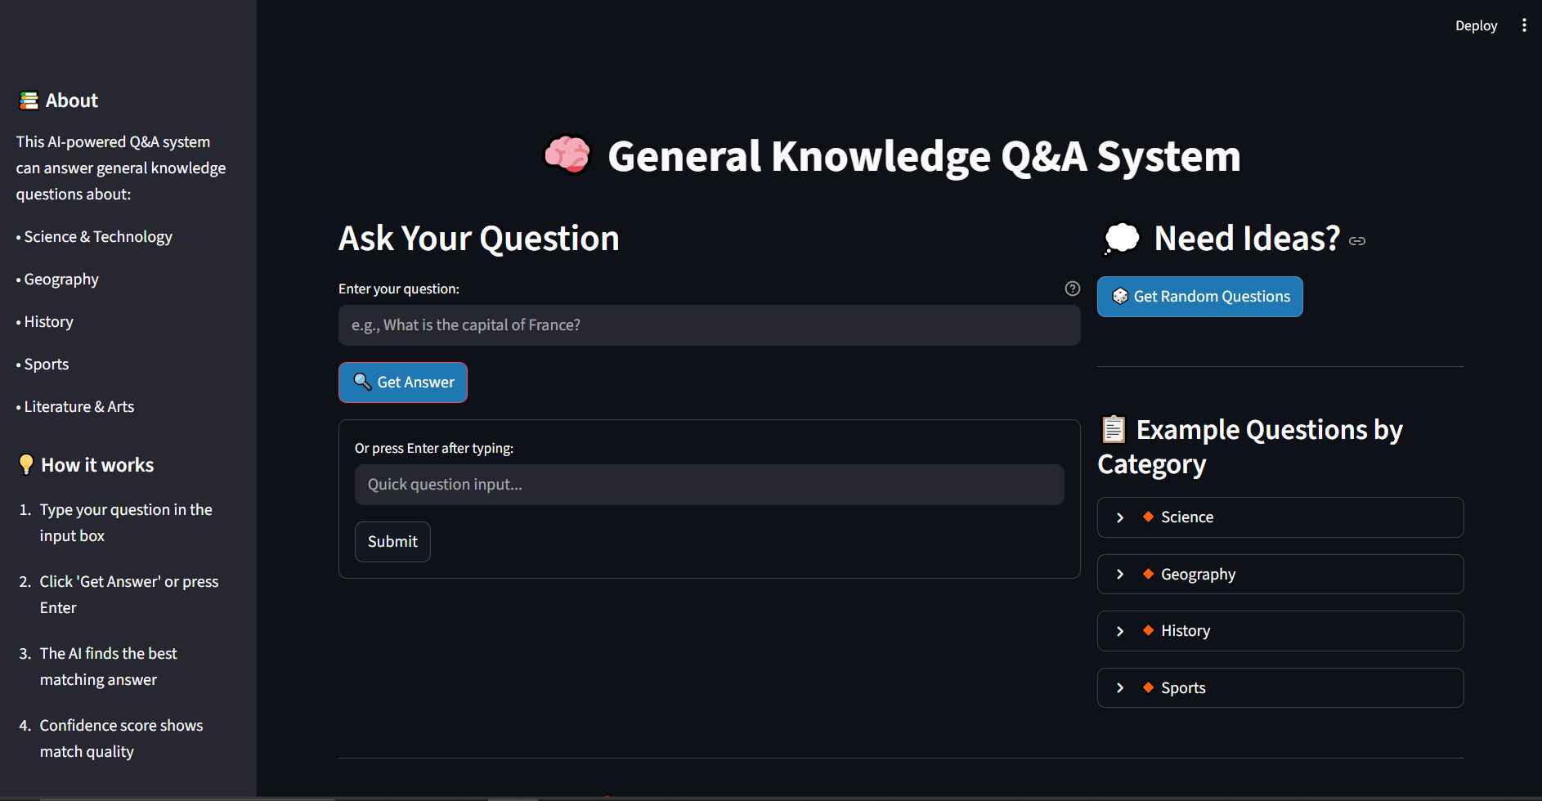
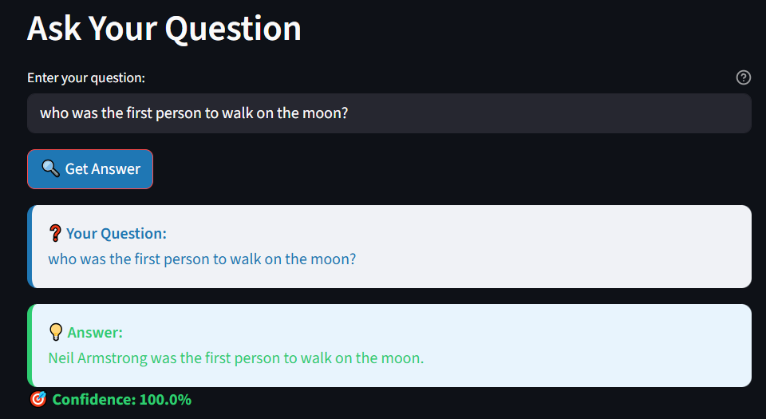
User Interface Snapshot
A glimpse into the intuitive and user-friendly interface of the User Question Answering

Slide 9
Future Enhancements
Our roadmap includes several key improvements to expand the User Question Answering capabilities and enhance user experience.
Integrate with LLMs, APIs, expand categories.
Educational value: Useful for quizzes, learning apps, and testing knowledge.

Slide 10

Thank You!
Questions? Feedback?

